Slide 1
Maker’s university – by intel’s makers community class 4 – Remote access
Gil Tal.
Jan 2020

Slide 3
Class 4 agenda:
Control and communication over the air
Wi-Fi
Bluetooth
Wi-Fi basics
Webserver
Micro DNS
ESP-Now protocol
Useful web services and protocols
IOT
Bluetooth
OTA (Over The Air update)

Slide 4
Wi-fi basics
Wi-Fi basics:
Family of wireless networking technologies
IEEE 802.11 family of standards
Used for local area networking of devices and Internet access
20-150 meters range
Standard defines 16 channels for communication
Enables multiple access points at the same physical location

Slide 5
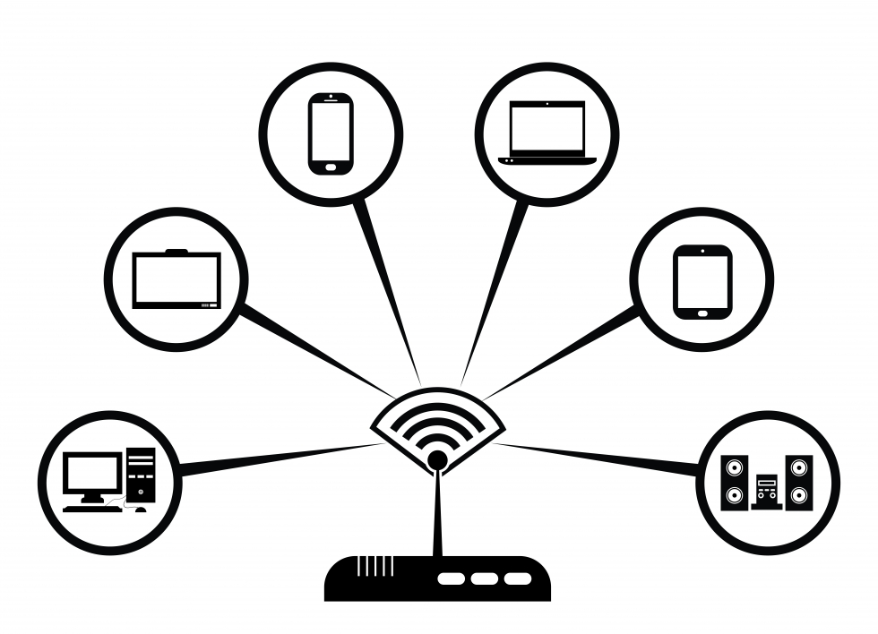
Wi-fi basics: AP and sta
End Point device
AP – Access point
Enable the creation of a local Wi-Fi network
We connect to an access point
With or without access to the internet
Uses a specific channel which can be modified while operating
Has limitation for number of connected devices
Has a name and an optional password
Can use an encrypted communication protocol
STA – Station
An end point device
Connects to an AP
While searching for an AP needs to try different channels until found
AP

Slide 6
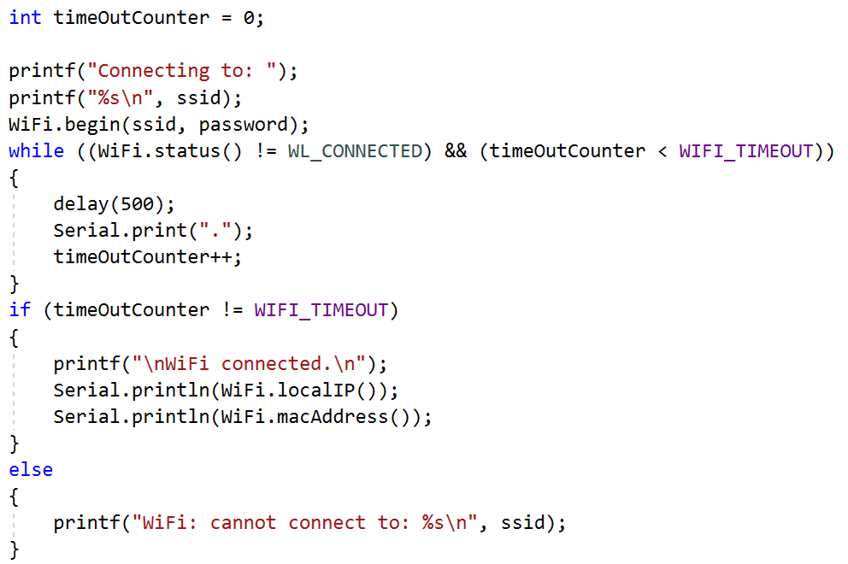
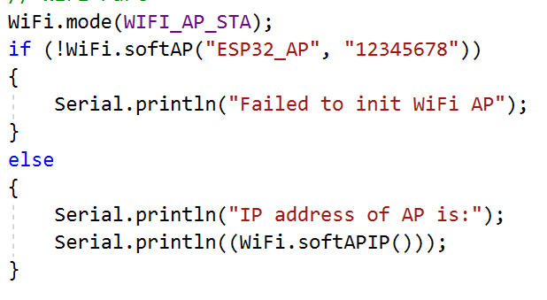
Wi-fi basics: our esp32
Runs full network stack
Can function as:
AP
By default enables up to 4 users
STA
Both*

Slide 7
webserver
Web pages are hosted on a webserver
Most commonly written in HTML5 + JAVA script
There are various HTML5 emulators out there
Has a specific IP address (192.168.14.1 for example)
Is a passive device
We need a browser to access it
Browser is executing the HTML5 code
The communication protocol is HTTP
There are large number of hosting providers
IP address can be replaced by a name
DNS server translates the name to the specific IP address
ESP32 can run a webserver! ☺

Slide 8
Webserver – what can we do with it
Have a nice GUI to communicate with the ESP32 using a browser
Control IOs
Get information from our ESP32
Such as temperature, humidity depending on what we connected
Send data to the ESP32
Files
Raw data

Slide 9
Webserver – work flow
We need to initialize:
WiFi
Webserver
Prepare the HTML for the pages
Handle the client which interacts with the browser
Process the incoming data from the browser to perform actions on the ESP

Slide 10
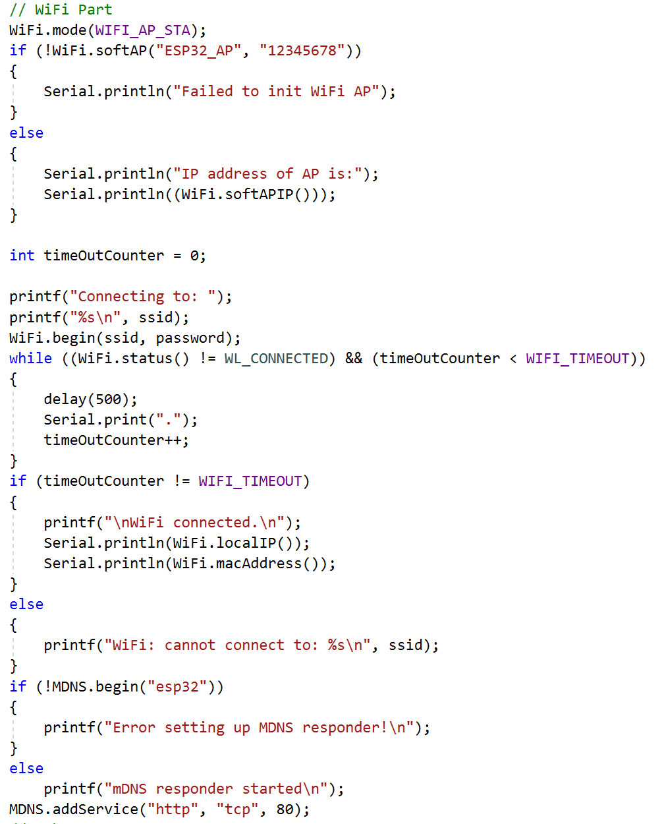
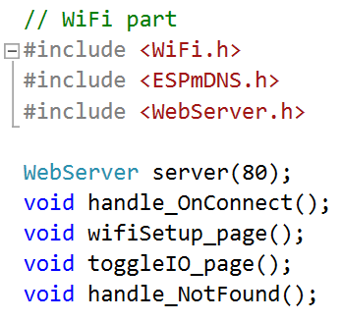
Webserver – Init code

Slide 11
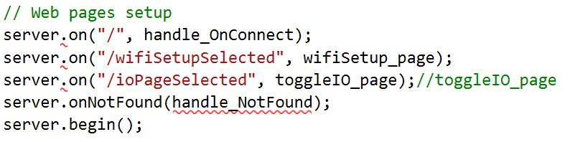
Webserver – INIT code

Slide 12
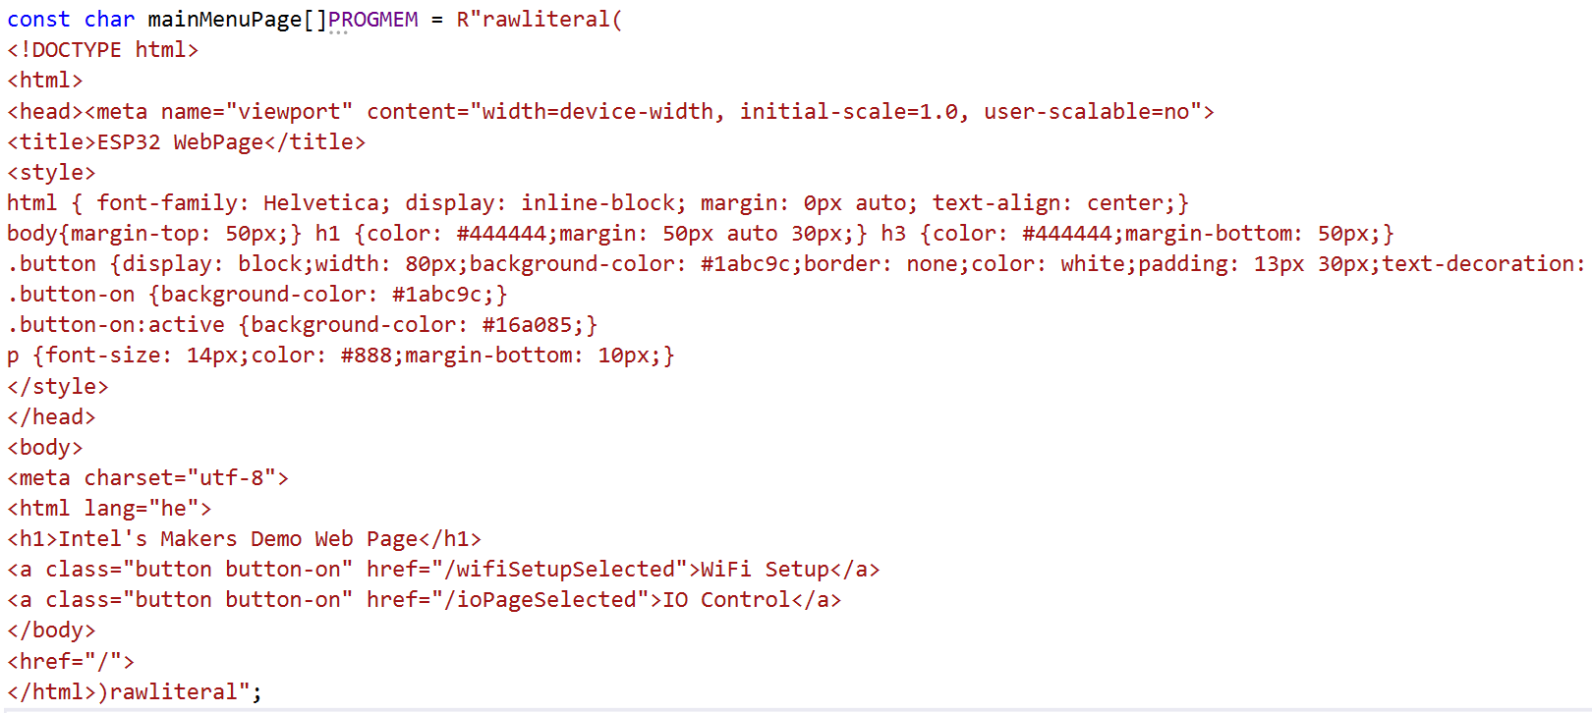
Webserver – html data

Slide 13
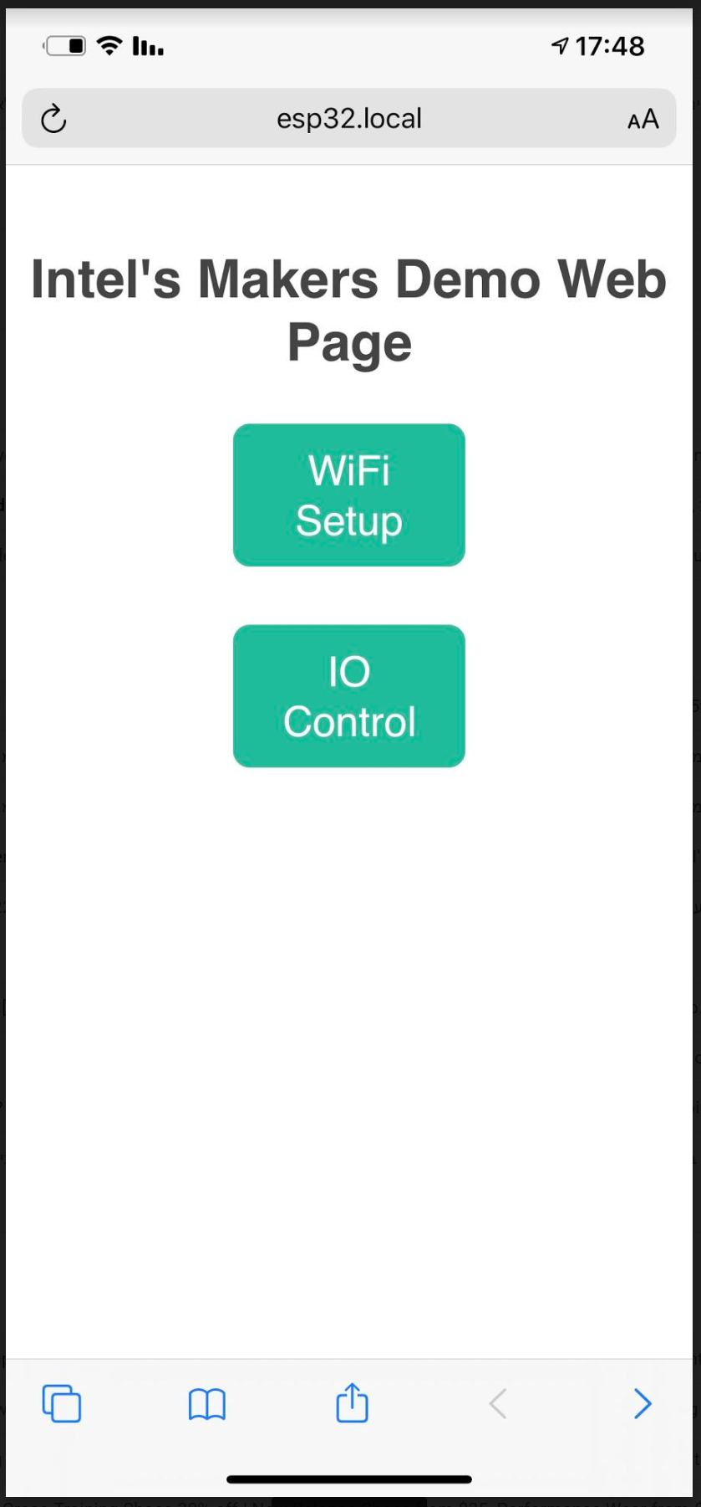
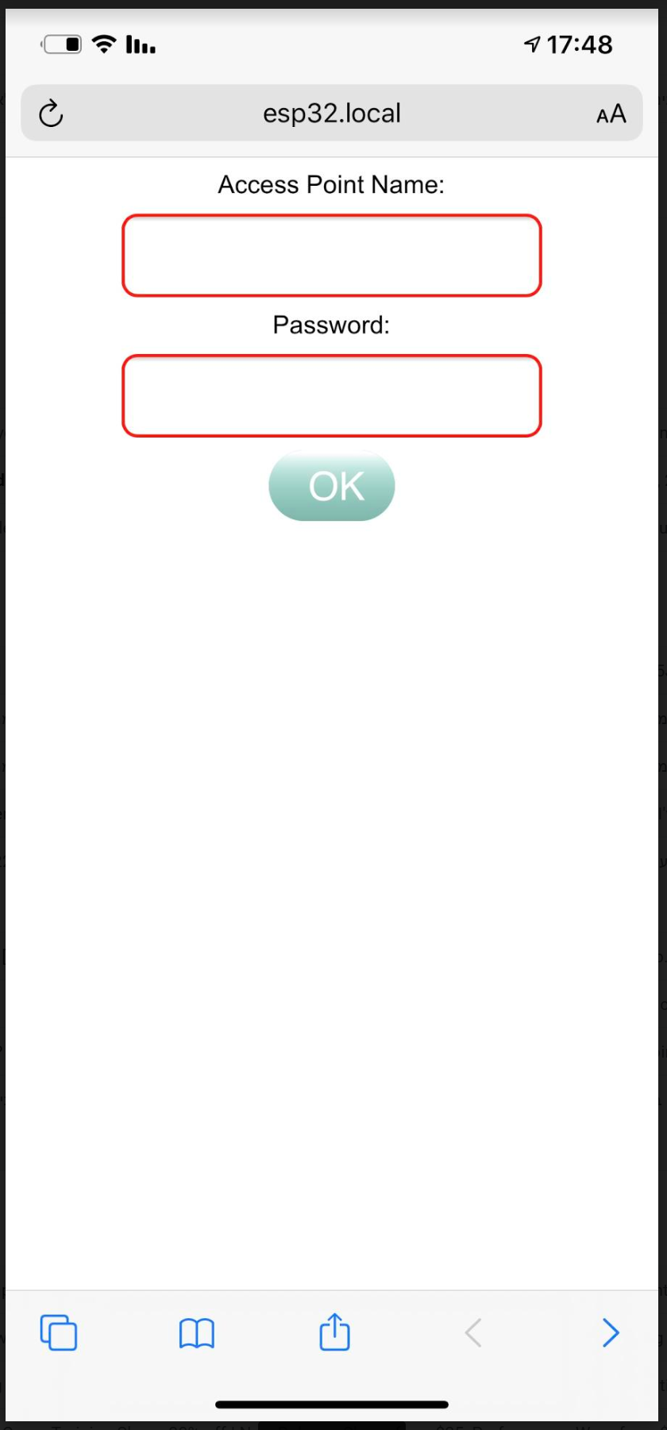
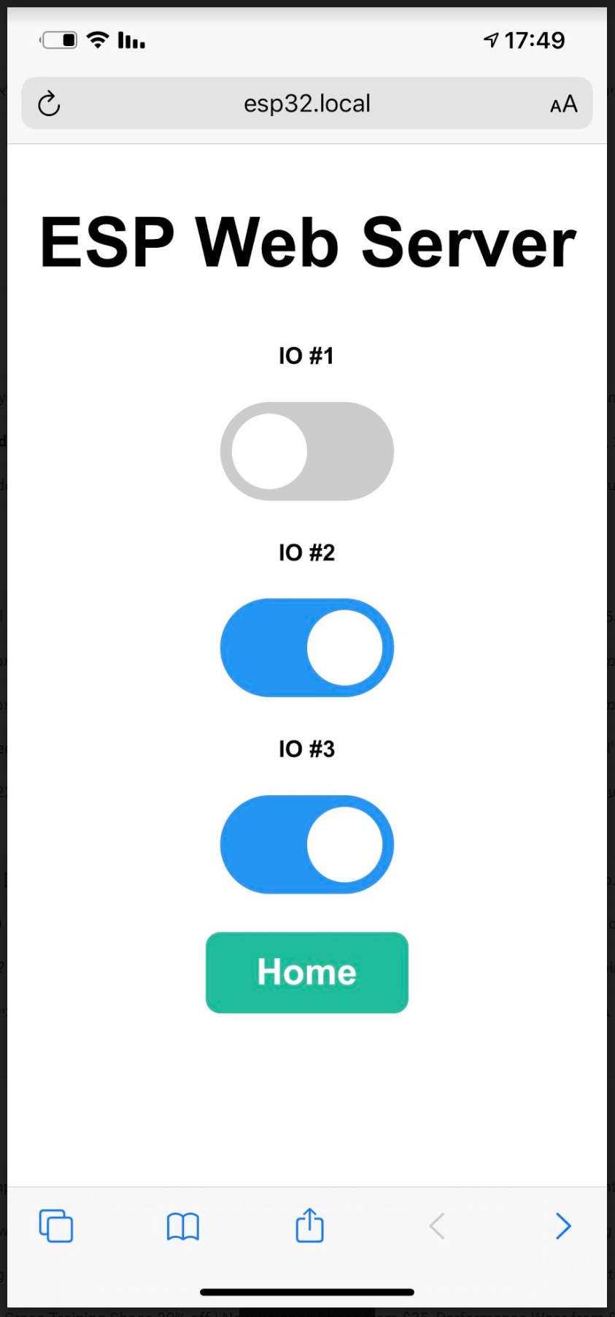
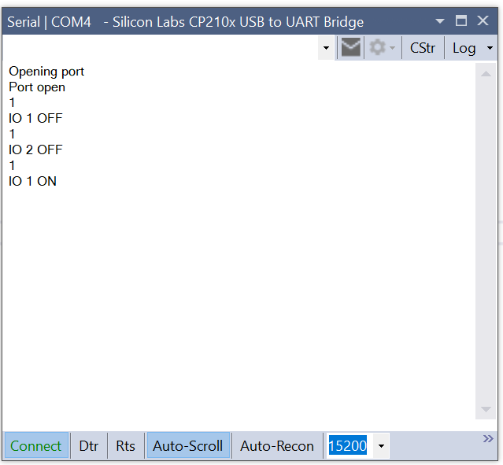
How does it looks…

Slide 14

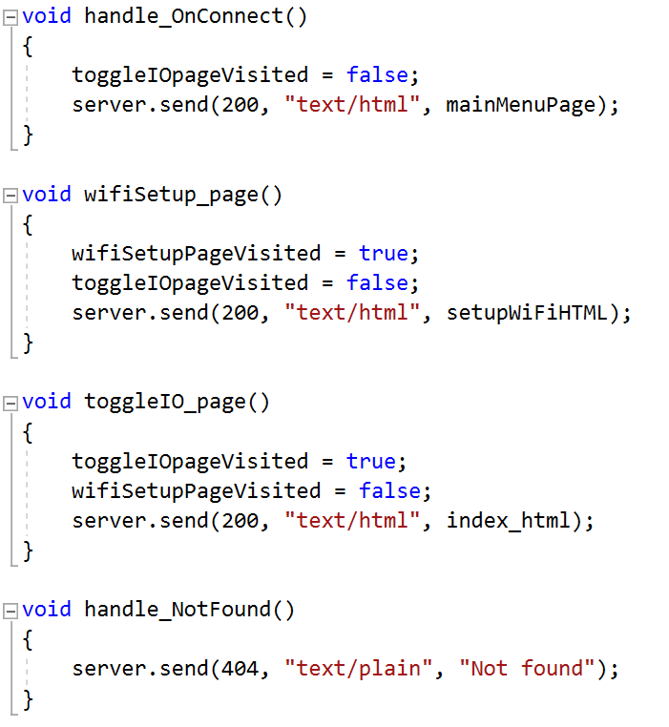
Webserver – handle the client

Slide 15
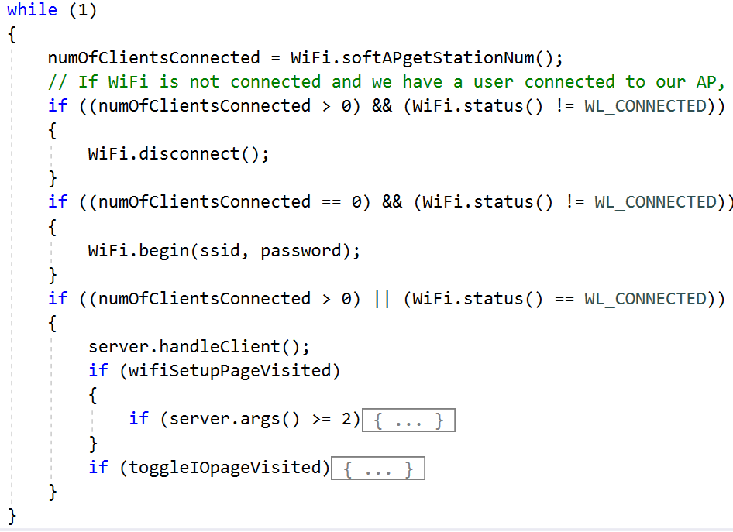
Webserver – processing incoming data

Slide 16
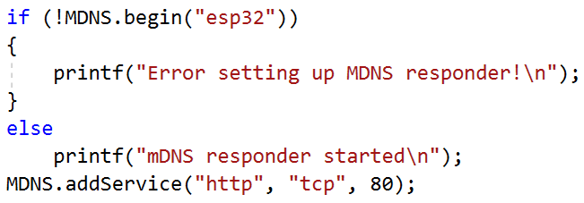
Multicast DNS
Domain Name System
MDNS – Is a zero-configuration service
Enables usage of names instead of IP address
Our ESP32 runs Multicast DNS (MDNS)
Windows and Apple devices can work with MDNS
Sadly Android does not ☹
Usage:
http://esp32.local/
No MDNS support - http://192.168.14.1/ (just an example IP)

Slide 17
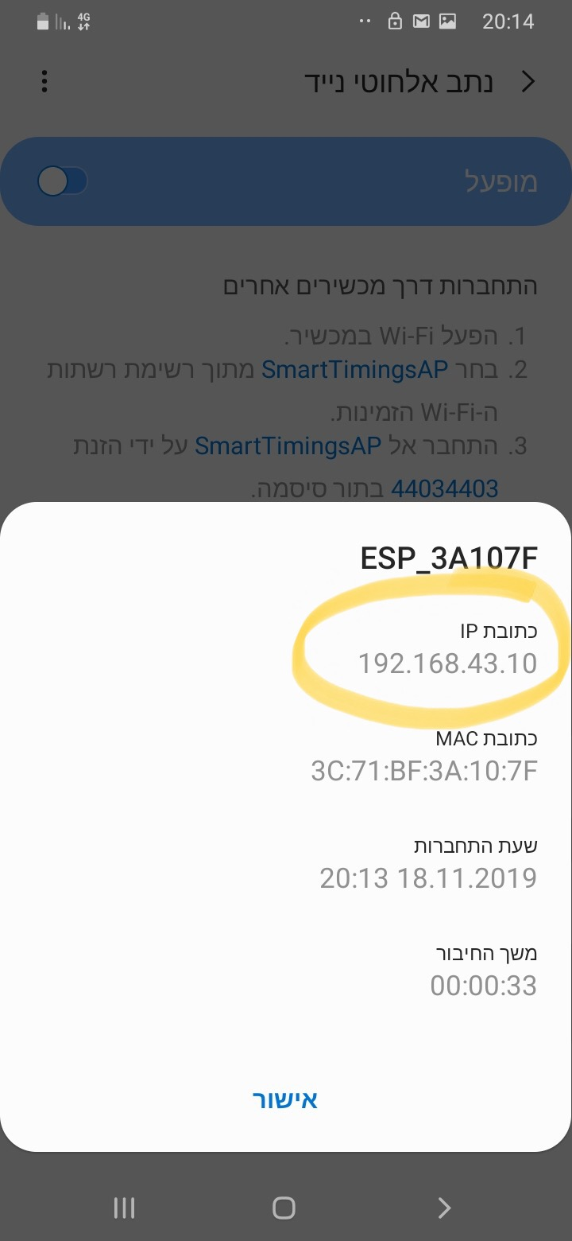
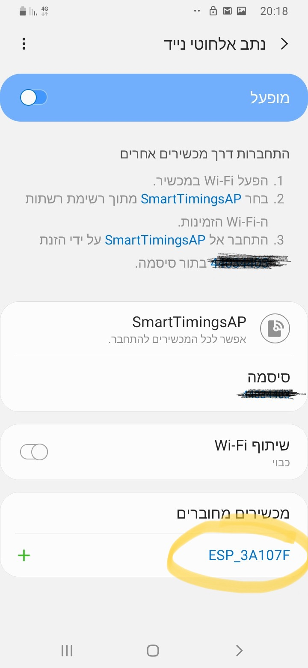
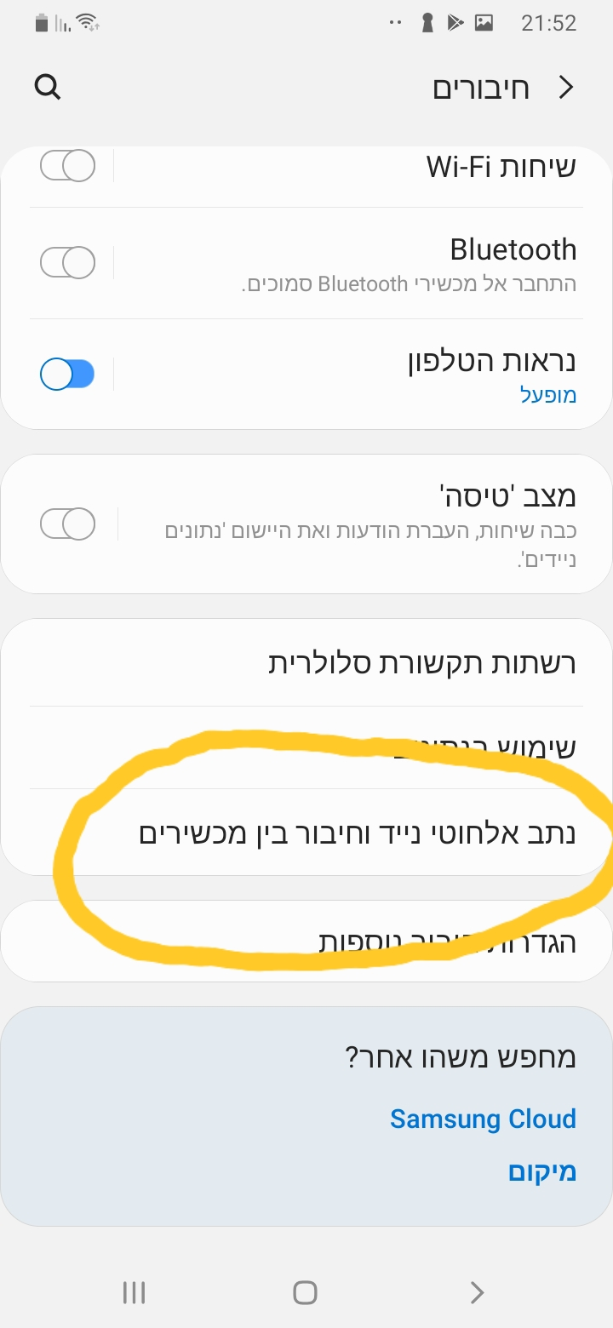
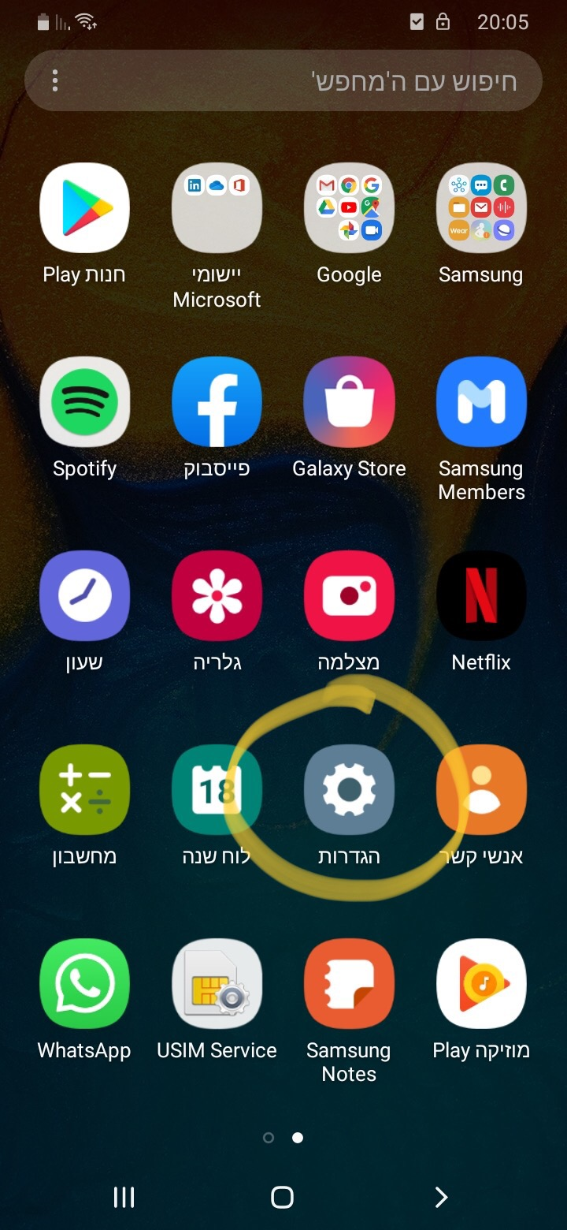
No mdns on Android so… (buy an iPhone ☺ or)

Slide 18

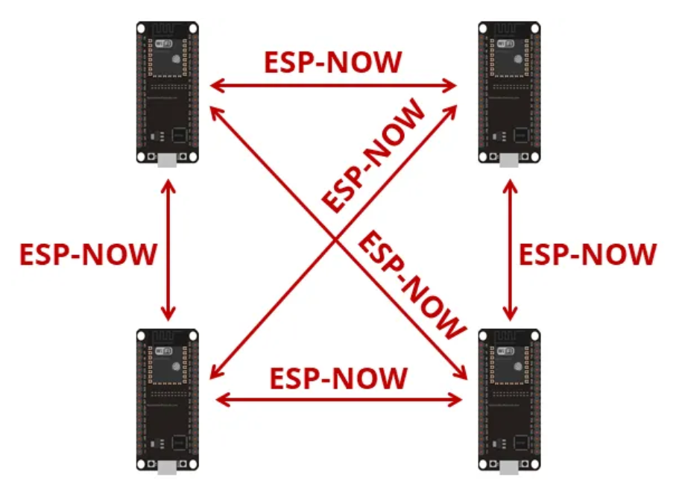
Protocol developed by Espressif
Enables multiple devices to communicate without using Wi-Fi
Low-power 2.4GHz wireless connectivity
Encrypted and unencrypted unicast communication
Up to 250-byte payload can be carried
10 encrypted peers at the most (STA mode), 6 for SoftAP or STA + SoftAP

Slide 19

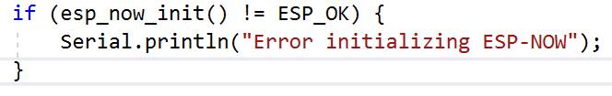
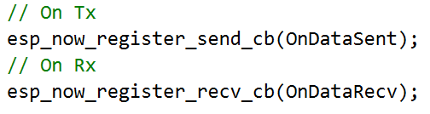

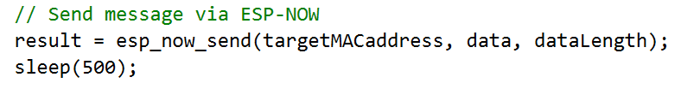
Esp-now
Works with MAC address
Need to know the our MAC and the Peer’s
Initialize the protocol
Register callback functions for send and receive
Register peers
Upon sending the send function will be called:
With status
With the MAC of the targeted peer
Upon receiving the receive function will be called:
With the MAC of the sender
With the received data

Slide 20
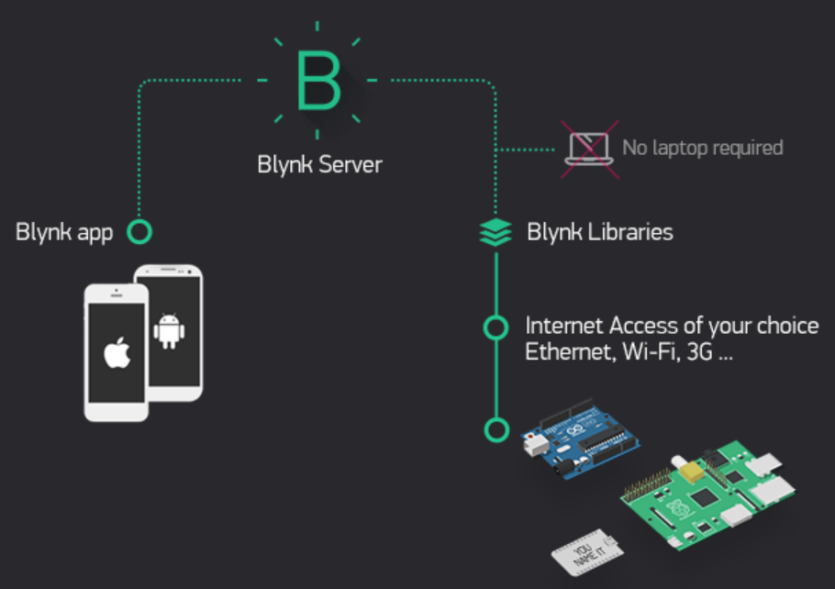
IOT – Controlling our ESP32 over the cloud
Using the ESP’s WIFI
We need to connect to a hotspot with internet access
We need a service provider to enable via cloud activity such as
Control I/Os
Get and push data to our ESP
There are many cloud service providers out there
I prefer using Blynk (more on the next slide ☺)

Slide 21

IOT – BLYNK
Works via application on a phone or tablet (No web or PC apps)
Can work via Wi-Fi or Bluetooth
The application is very easy to use and very powerful
Code is extremely simple to manipulate using a dedicated library
Has a code wizard generator on their website
Wi-Fi and Bluetooth code is the same, only small change in initialization
Automatic application sync for all used devices
Android supports widgets
We can use our own server!!
Blynk have a service to generate an application for us to be published on app store
Look at the course GIT for a user guide and a demo code

